Slide 1

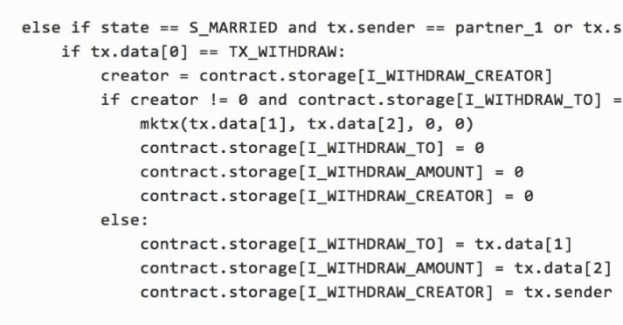





Town Crier:
An Authenticated Data Feed
for Smart Contracts
Fan Zhang*, Ethan Cecchetti, Kyle Croman, Elaine Shi, and Ari Juels
*fanz@cs.cornell.edu
Notes:
I’m going to talk about smart contracts and the challenge of authenticated data feeds and our solution, Town Crier.
This is a data feed system,proveide auyhenticated data feed for smart contract

Slide 2
What’s a (decentralized) smart contract?
Executable object on blockchain
Programed in Turing-complete languages
Code can define arbitrarily rich functionalities
Decentralized ➜ autonomous: Execution enforced by network
Contract
Abstraction: Smart contract is virtual trusted third party with *public* state.
Notes:
I’m describing smart contracts here in the sense of Ethereum, the best known smart contract system, which has recently launched
Execution enforced by network: Just as you can't stop payments in Bitcoin, no one can prevent a contract from executing… with certain notable exceptions.
The abstraction we promote is to view smart contract as a virtual trusted third party with public state.

Slide 3
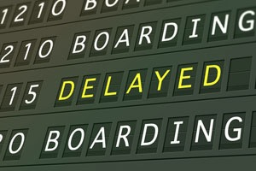

Running example:
Self-enforcing flight delay insurance
Gimme a policy for Flight #1234 on 17 May for a policy price $1.
Flight
Insurance
$1
$100
Notes:
throughout this presentation, We’ll use a smart contract for flight delay insurance as a running example. As its name suggests, with such as an insurance, one can purchase policies for her flight and gets paid back if the flight is delayed. With a trusted third party (as in this case), it is trivial to implement this insurance.
Luckily, a smart contract is such a third party that we can trust for its integrity. So it sounds like we can drop in a smart contract and we’re good to do.

Slide 4
Virtual Trusted Third Party
Gimme a policy for Flight #1234 on 17 May for a policy price $1.
Only this doesn’t work.
Flight
Insurance
$100
Notes:
A smart contract enables us to do exactly the same as with a virtual trusted third party.

Slide 5
Smart contracts are data-hungry, but…
Gimme a policy for Flight #1234 on 17 May for a policy price $1.
Flight
Insurance
x
$100
Notes:
One critical piece is missing. Blockchains are self-contained (can't browse internet). Data must be injected from user account!

Slide 6


Interesting smart contracts need trustworthy data
Smart Contract
Webpage
contents
Stock quotes
Commodity
prices
Current
events
Weather
data
Sports
results
Today there are no good sources.
Notes:
You'll hear a lot today about smart contracts. Smart contracts are one of the most exciting developments in blockchain technology.
If it's a financial instrument it needs access to equity prices. [Animation] Other smart contracts may need commodity prices, webpage contents, etc.
Smart contracts are data-hungry blockchain objects and today there's a lack of good ways to feed them. There are no robust and highly trustworthy data feeds.

Slide 7
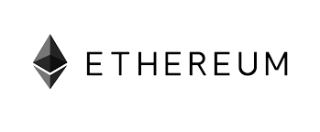
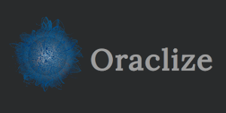



Proposed data-delivery approaches
Prediction markets (e.g., Gnosis)
Oracles, e.g., Oraclize.it
Strong trust assumption
Raw data format
No Confidentiality
Big data brokers serve data
Blockchain
Smart
Contract
Notes:
oraclize.it: (1) Relies on reputations of small entities (TLSnotary + oraclize.it); (2) raw data format; (3) No confidentiality
Big brokers: (1) Hasn't happened; (2) Source fragmentation; (3) Confidentiality?

Slide 8
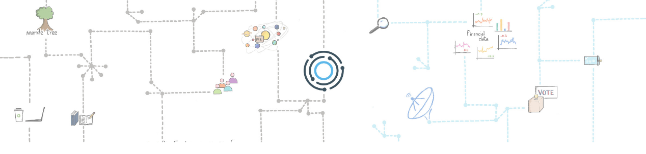
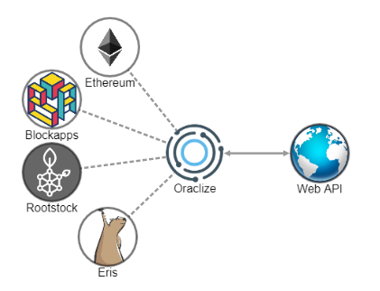
Oraclize
HOW IT WORKS
data carrier for decentralized apps
Smart contracts live like in a walled garden, they cannot fetch external data on their own. Oraclize is here to help. We act as a data carrier, a reliable connection between Web APIs and your Dapp. There is no need to open additional trustlines as our good behaviour is enforced by cryptographic proofs.

Slide 9

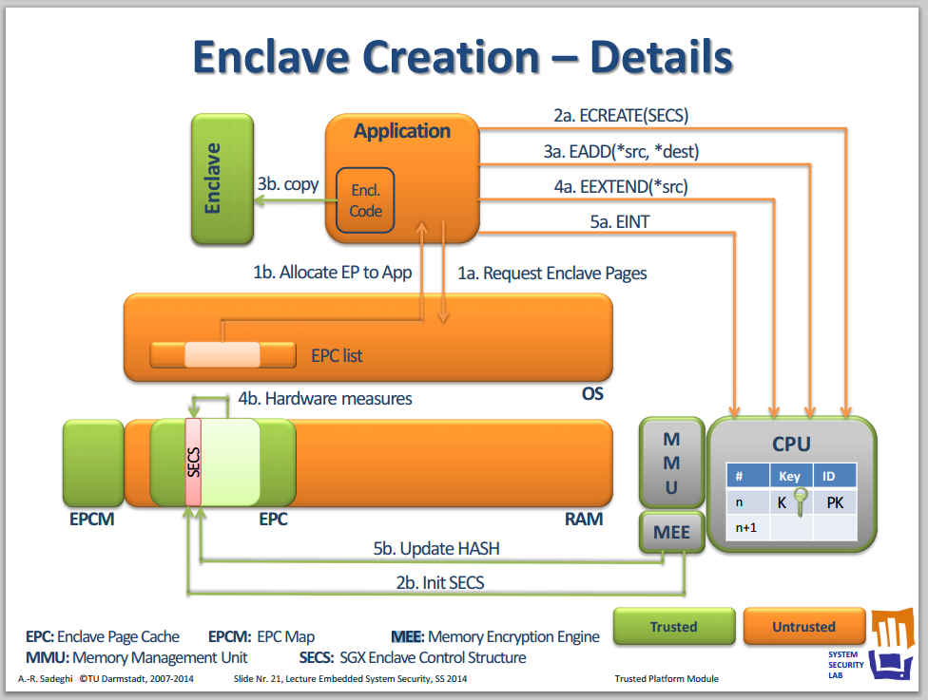
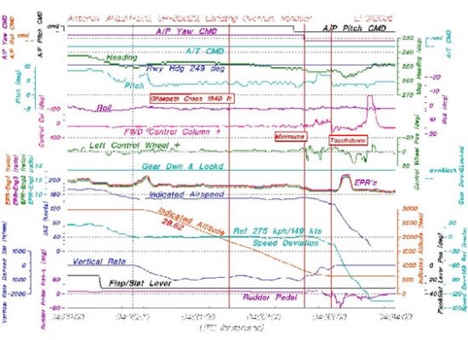
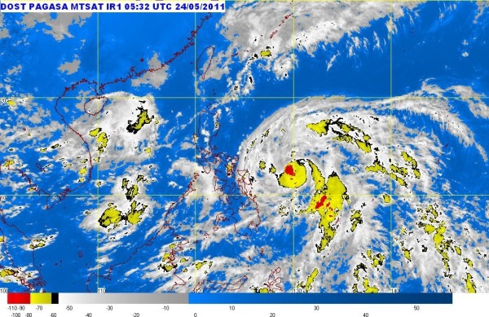
Town Crier
Fan Zhang, Ethan Cecchetti, Kyle Croman,
Elaine Shi, and Ari Juels. Town Crier: An Authenticated
Data Feed for Smart Contracts. ACM CCS. 2016.

Slide 10

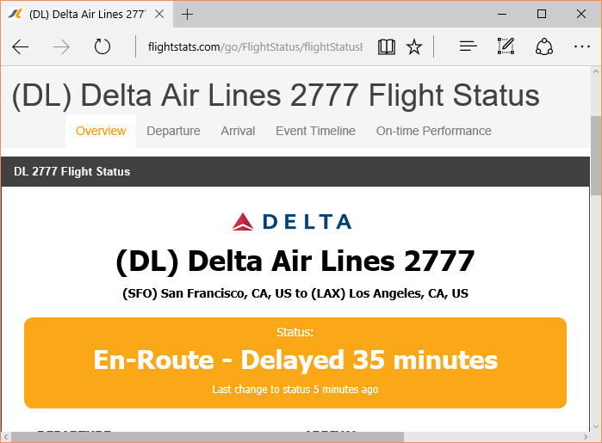



Town Crier (TC): Basic Idea
Blockchain
Trusted Website XYZ.com
Is DL 2777 delayed?
Flight
Insurance
Town
Crier
Authenticity property: Data delivered by TC is exactly as served on source site XYZ.com

Slide 11





How to ensure authenticity?
Blockchain
Trusted Website XYZ.com
Flight
Insurance
Town
Crier
SGX

Slide 12








Intel SGX: Isolation
Integrity
Confidentiality
SGX
Program X
Other processes and even OS cannot tamper with control flow of X
Other processes and even OS can learn nothing* about the state of X
Enclave
* Side-channels like page faults excepted
Notes:
完整性 机密性

Slide 13

Intel SGX: Remote attestation
SGX HW Secret Key
Flight
Insurance
SGX
attestation att =
𝚺intel[ X || User data]
Program X
Program Image
Remote Platform
X is running on a genuine SGX platform
*Signature 𝚺 (EPID) can be anonymous (group) or pseudonymous

Slide 14
Intel SGX: Secure Channel
SGX HW Secret Key
Certificate
Flight
Insurance
SGX
attestation att =
𝚺intel[ X || User data]
Program X
Program Image
Remote Platform
SKX
PKX
*Signature 𝚺 (EPID) can be anonymous (group) or pseudonymous

Slide 15







TC goal / adversarial model
Relying contract sends query Q = (XYZ, params, T) to TC
Goal: TC returns correct answer A to query Q
Adversary controls the OS of TC server and the network
Simpler view: adversary controls network outside enclave
Blockchain
Trusted Website XYZ.com
Flight
Insurance
Town
Crier
SGX
Notes:
Another way to look at this is that the adversary controls the network, which includes everything outside the enclave and two other components

Slide 16








Tripartite trust model
Smart contract
Trustworthy execution
No confidentiality
Expensive computation
TC enclave
Trustworthy execution
Cheap computation
No network stack
Trusted website
Source authentication
No digital signatures on content
Key Challenge: How does one stitch together disparate trust domains with different properties into a secure, effective system?
Blockchain
Flight
Insurance
TC
Contract
Town
Crier
SGX
Compound Program
Notes:
From now on I’ll describe how we addressed this problem for smart contracts while solving the critical problem of secure data delivery.

Slide 17
Blockchain
Trusted Website XYZ.com
Flight
Insurance
Town
Crier
SGX

Slide 18
Blockchain
Trusted Website XYZ.com
Flight
Insurance
Town
Crier
SGX
Solution: use attestations to establish secure channel
Notes:
如何保证数据来自TC而不是隔壁老王

Slide 19
Blockchain
Trusted Website XYZ.com
Flight
Insurance
Town
Crier
SGX
Creator of Flight Insurance checks
Contract Flight insurance:
Hardwired with PKTC
On receiving flight data, checks signature 𝚺SK_{TC}[flight data]
Free!
Notes:
由Blockchain进行verification

Slide 20
Blockchain
Trusted Website XYZ.com
Flight
Insurance
Town
Crier
SGX

Slide 21

Blockchain
TC Contract
Flight
Insurance
A'
A'
Town
Crier
Q'
Q
Problem: Q' may be corrupted version of Q—or altogether fake!
Could run blockchain client (Ethereum) in enclave
Could verify Q from blockchain
Would bloat TC code (TCB)!

Slide 22
Blockchain
TC Contract
Flight
Insurance
A'
A'
,Q'
Q'
Town
Crier
Q'
Q
Our approach: Leverage hybrid trust model
Potentially corrupted query Q' processed by TC
TC digitally signs (A', Q') using SKTC
TC contract verifies Q = Q'

Slide 23
Blockchain
Trusted Website XYZ.com
Flight
Insurance
Town
Crier
SGX
Notes:
Solution: Free!
TLS connection terminates in enclave
We just need to trust (attested) TC code to fetch correct data

Slide 24







Blockchain
Trusted Website XYZ.com
Flight
Insurance
Town
Crier
TLS
?
TCP
SGX
Problem: network is controlled by OS
HTTPS doesn't sign data (MAC is not transferrable).
TC can not verified data delivered by OS
Solution:
Put TLS stack in the enclave
Notes:
Solution: Free!
TLS connection terminates in enclave
We just need to trust (attested) TC code to fetch correct data

Slide 25
Another problem:
Gas depletion
Recall: Ethereum uses currency called "gas"
Prevents DoS
Charges fairly for computation costs
Blockchain
Smart Contract
Smart Contract'
TC
Account
msg,
$gas
msg'
$gas'

Slide 26
Another problem:
Gas depletion
TC service needs to initiate call to return data A
TC must pay gas cost for this return call… yet avoid malicious gas-depletion calls from other contracts
Blockchain
Flight
Insurance
TC
Contract
Town
Crier
SGX

Slide 27







Gas sustainability
Informally: service never runs out of gas
Formal definition in paper
TC requires up-front deposit of gas (ether) from relying contract
Formal proof of gas sustainability for TC in paper
Gas sustainability is a fundamental and general availability property for compound smart contracts!
Blockchain
Flight
Insurance
TC
Contract
Town
Crier
SGX

Slide 28


Challenge of Confidentiality
Blockchain
Smart contract
How to provide confidentiality for data processed by a smart contract with no confidential state?

Slide 29
Running example: Self-enforcing flight delay insurance
Gimme a policy for Flight #1234 on 17 May for a policy price $1.
Flight
Insurance
$100
Notes:
This isn't great, but one can think of still worse examples, like financial instruments that disclose people's trades

Slide 30






Idea: Leverage enclave confidentiality
Flight delayed /
not delayed
Blockchain
Flight
Insurance
TC
Contract
Town
Crier
$$$
SGX
Private datagram!
Additional steps needed
E.g., delay response / payment to noise timing side-channel

Slide 31

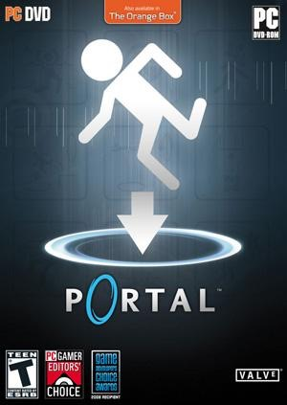
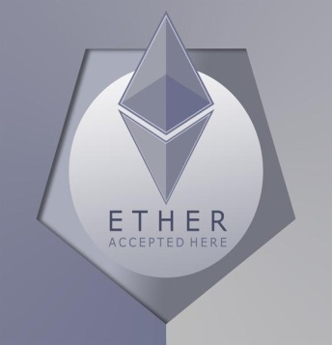



Applications: TC for sale of online goods
Steam Community Marketplace (SCM): buy and sell items with community members
Alice wants to sell a game for Ether, but SCM doesn’t support.
Online game license
Ether
Community Marketplace

Slide 32

Smart contract for fair exchange
Blockchain
Town
Crier
Steam Trader
SGX

Slide 33

Smart contract for fair exchange
Blockchain
Town
Crier
Steam Trader
SGX
as a gift ($0) through
Community market

Slide 34
Smart contract for fair exchange
Has Alice delivered the game?
Blockchain
Delivered!
Town
Crier
Steam Trader
SGX

Slide 35

Challenges
Blockchain
Confidentiality: This requires Alice's (or Bob's) Steam marketplace credentials
Customization: Sending raw data to SteamTrader incurs high overhead.
Steam Trader
Notes:
For fair exchange SteamTrader needs to verify delivery

Slide 36








Again, we can leverage SGX
HTML
Blockchain
Town
Crier
=Extract(HTML)
D
Steam Trader
D
SGX

Slide 37



Again, we can leverage enclave confidentiality
✓ A game has been delivered to Bob.
Alice’s Account
TC enables confidential smart contracts for nearly any digitally represented asset
($, cryptocurrency, online accounts, etc.)
Abstraction: Smart contract simulates trusted third party with public state.
Blockchain
✓ A game has been delivered to Bob.
Town Crier
Steam Trader

Slide 38

What if node or source is compromised?
✘
Town
Crier
✔︎

Slide 39

We can have
redundant sources
✔︎
Town
Crier
✔︎
✔︎
Majority vote!
✘

Slide 40
+ redundant nodes
Majority vote!
Town
Crier
Contract
Majority vote!
Majority vote!
Town
Crier
Majority vote!
Town
Crier

Slide 41
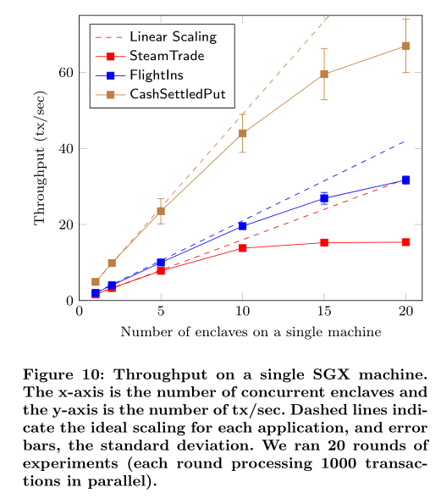

Slide 42
Town Crier
TC provides authenticated data feeds for smart contracts:
Has strong security & weak trust assumption
Preserves confidentiality
Supports customized data feed
Free version in Ethereum will be launched on Jan 1, 2017!

Slide 43
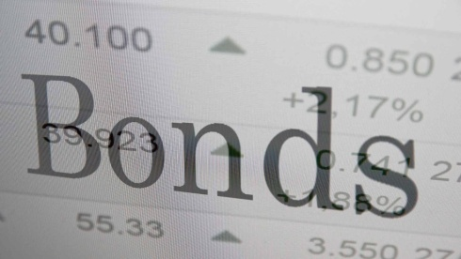
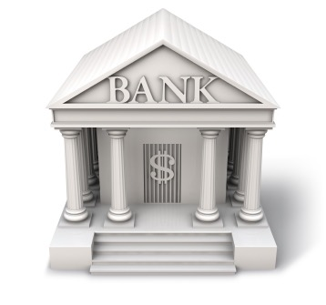
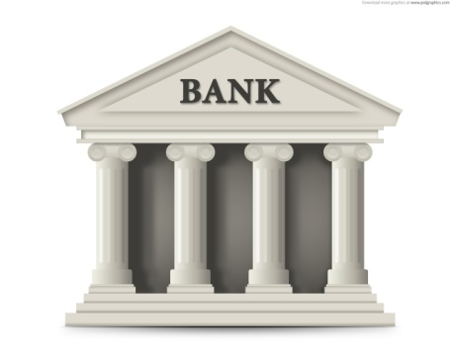
Private financial instruments with automated execution
Blockchain
Town
Crier
Financial Instrument
+ Confidential settlement

Slide 44
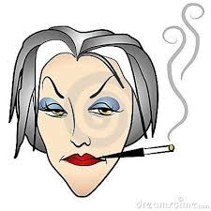

And some unsavory uses…
("Ring of Gyges" paper)
✓ Money delivered to Cruella.
Alice’s Account
Blockchain
✓ Stolen password for Alice's account works!
Town Crier
PasswordTheft
Alice's
password

Slide 45
Deployment plans
Free version in Ethereum on Jan 1, 2017
Exploring commercialization of enhanced functionality
TC good for permissioned blockchains too
E.g., Chain, HyperLedger / IBM (we're discussing with them…)

